Slide 1
Lord of The Rings Analysis

Slide 2
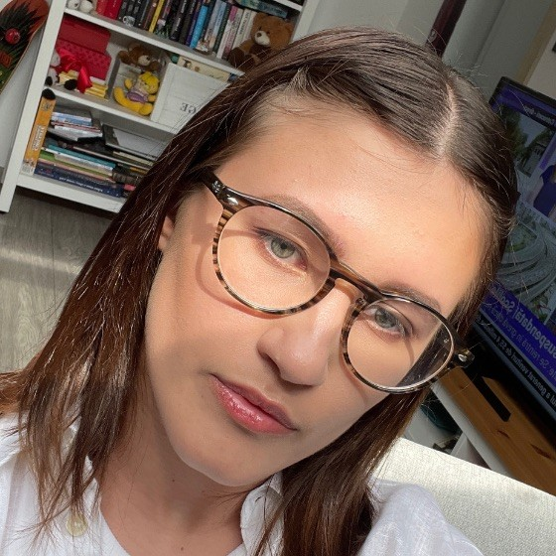

Our team
Anca Ariesanu
Eric Florea

Slide 3
Table of contents
01
Sentiment Analysis
02
Wordcloud
03
Conclusions
Sentiment Analysis for each chapter, book and overall series
Wordclouds for the main characters

Slide 4
01
Sentiment Analysis

Slide 5
-0.377
The happy events cannot outweigh the harsh trials
Overall Sentiment Value

Slide 6
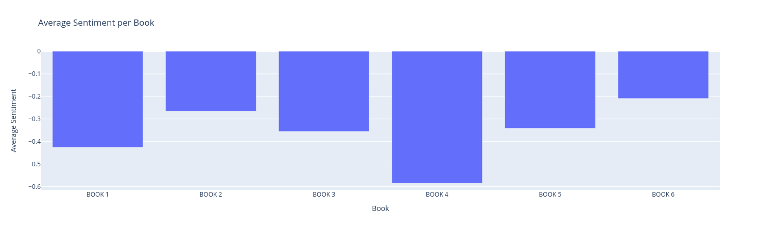
Sentiment Analysis per Book

Slide 7
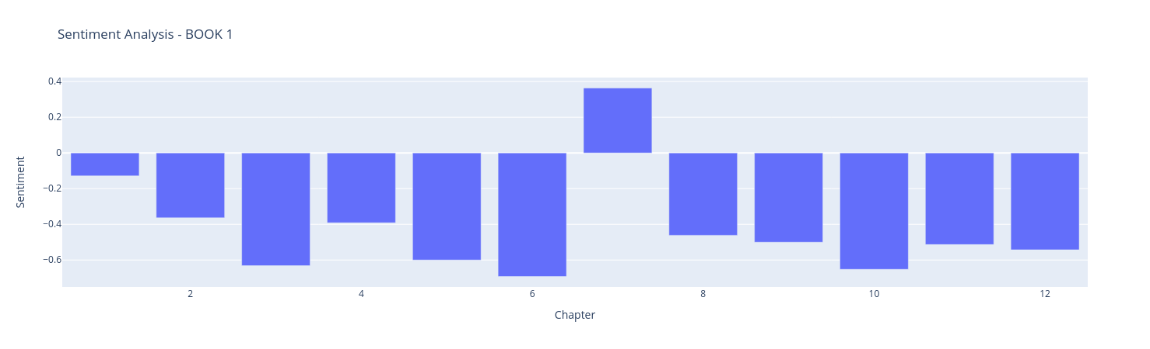
Sentiment Analysis of Book 1

Slide 8
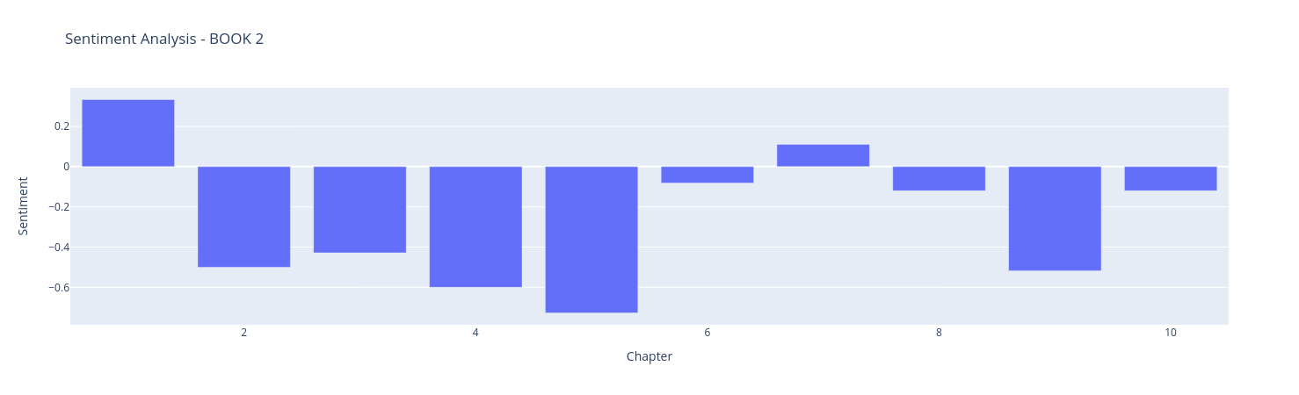
Sentiment Analysis of Book 2

Slide 9
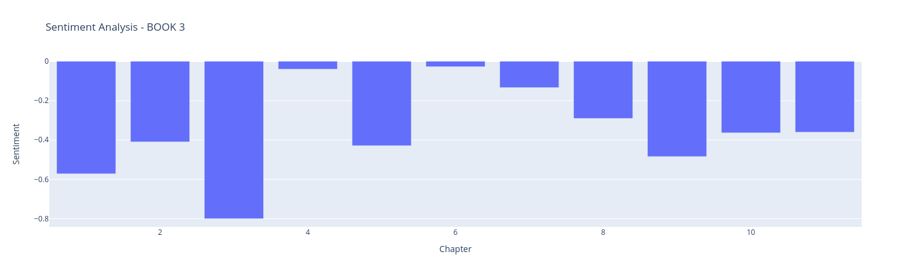
Sentiment Analysis of Book 3

Slide 10
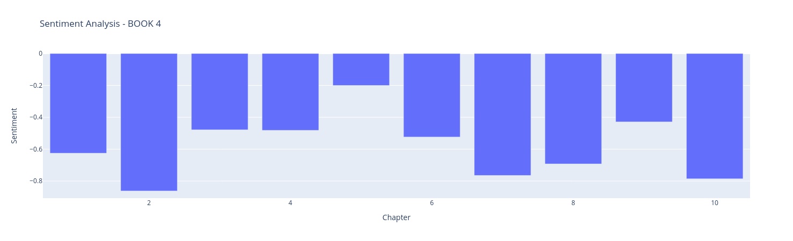
Sentiment Analysis of Book 4

Slide 11
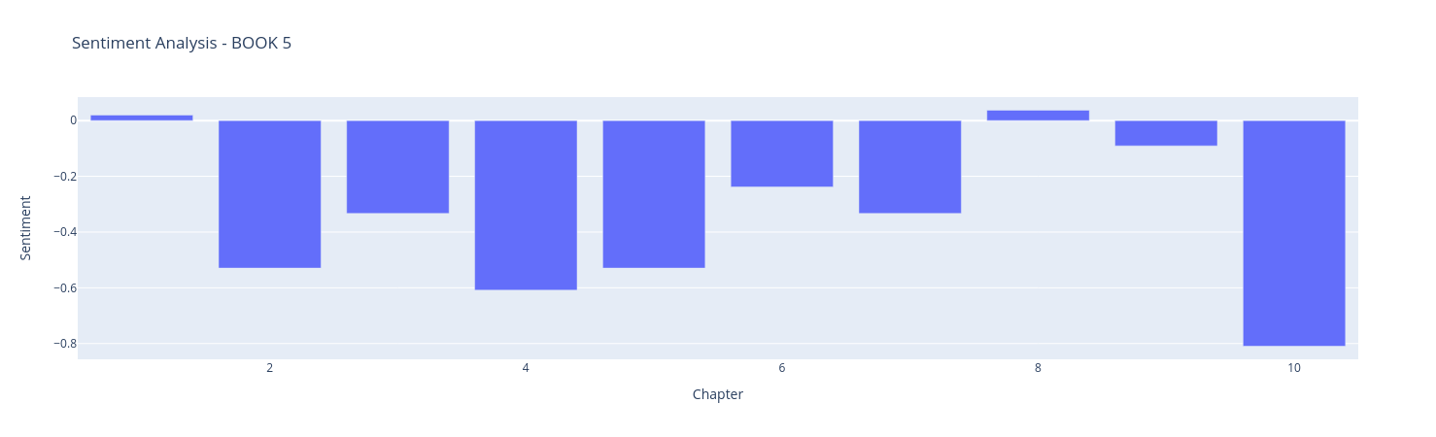
Sentiment Analysis of Book 5

Slide 12
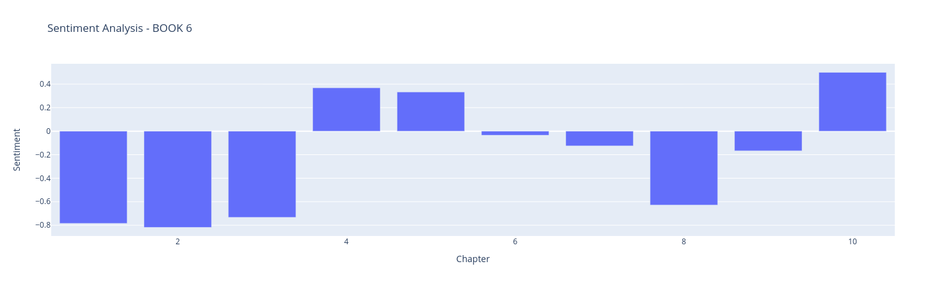
Sentiment Analysis of Book 6

Slide 13
02
Wordclouds

Slide 14
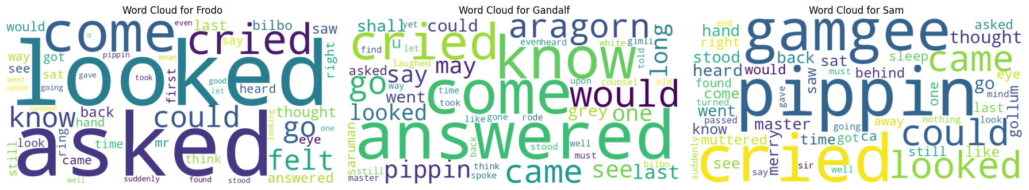
Top 3 Characters Wordclouds
1
Frodo: The Questioning Bearer
2
Gandalf: The Answering Sage
3
Sam: The Steadfast Friend

Slide 15
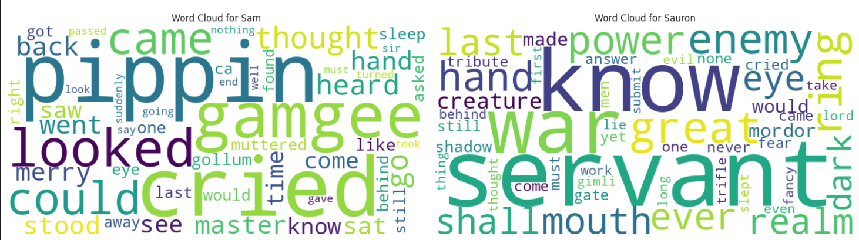
Sauron vs. Sam

Slide 16
03
Conclusions

Slide 17

What we learned from this?
The peak of Book 6 occurs between chapters 3 and 4, while Book 4, despite its unpredictability, maintains a consistently negative sentiment; however, the sentiment score rises toward the end of each book.
The overall negative sentiment score of -0.377 shows that the series is marked by significant challenges, enhancing reader engagement through the characters' struggles and triumphs.
1
3
The rise in sentiment scores towards the end of each book indicates deliberate character development and resolution, ensuring each book meaningfully advances the overarching plot.
We can easily tell by using a wordcloud how the characters are like in the story.
4
2

Slide 18
Thanks
Do you have any questions?

Slide 19
Resources
01
Github repo for project code
02
Github repo for book
03
Knowledge
https://github.com/ancaariesanu/DM_Project_LordOfTheRings
https://github.com/ganesh-k13/shell/tree/master/test_search/www.glozman.com/TextPages
Data mining lab papers from CV

